Slide 1

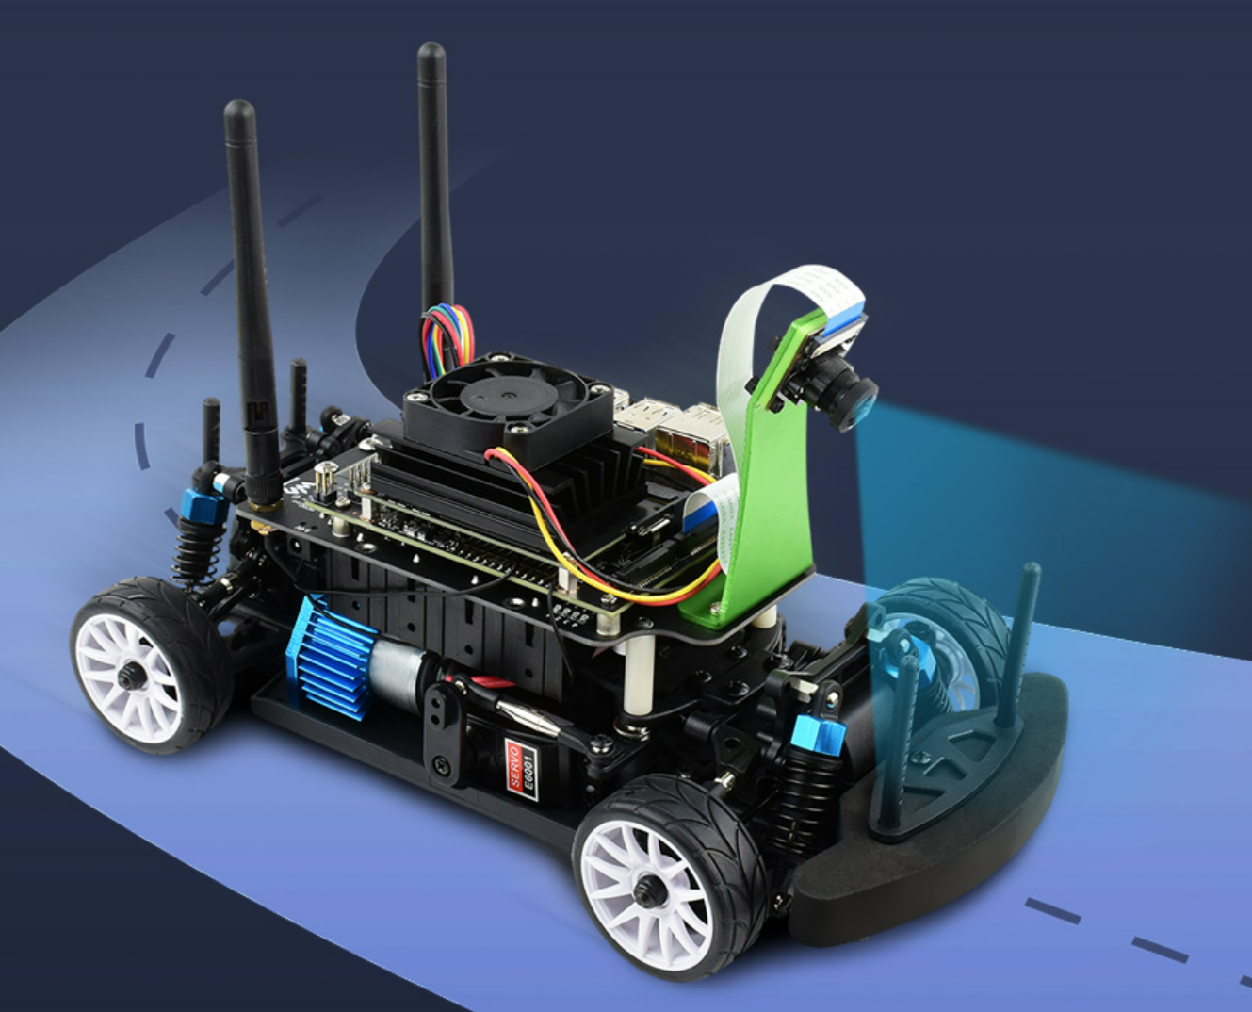


Virtual Vehicle Application Architecture with Telemetry Simulation
Simulation
Carla or AirSim
Feeder between Simulation and Kuksa.Val
Simulator API
VSS over gRPC
Kuksa.val Data Broker
In-Vehicle App
(optional)
Racer Control
VSS over gRPC
Build, Test & Deploy
Velocitas Dev Toolchain
Chariott App Programming Model
Velocitas Dev Container

Slide 2


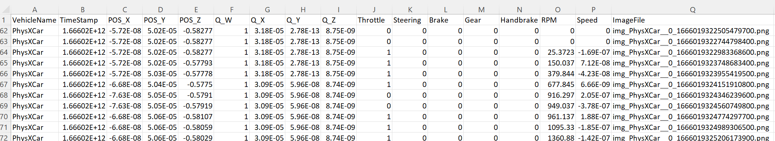
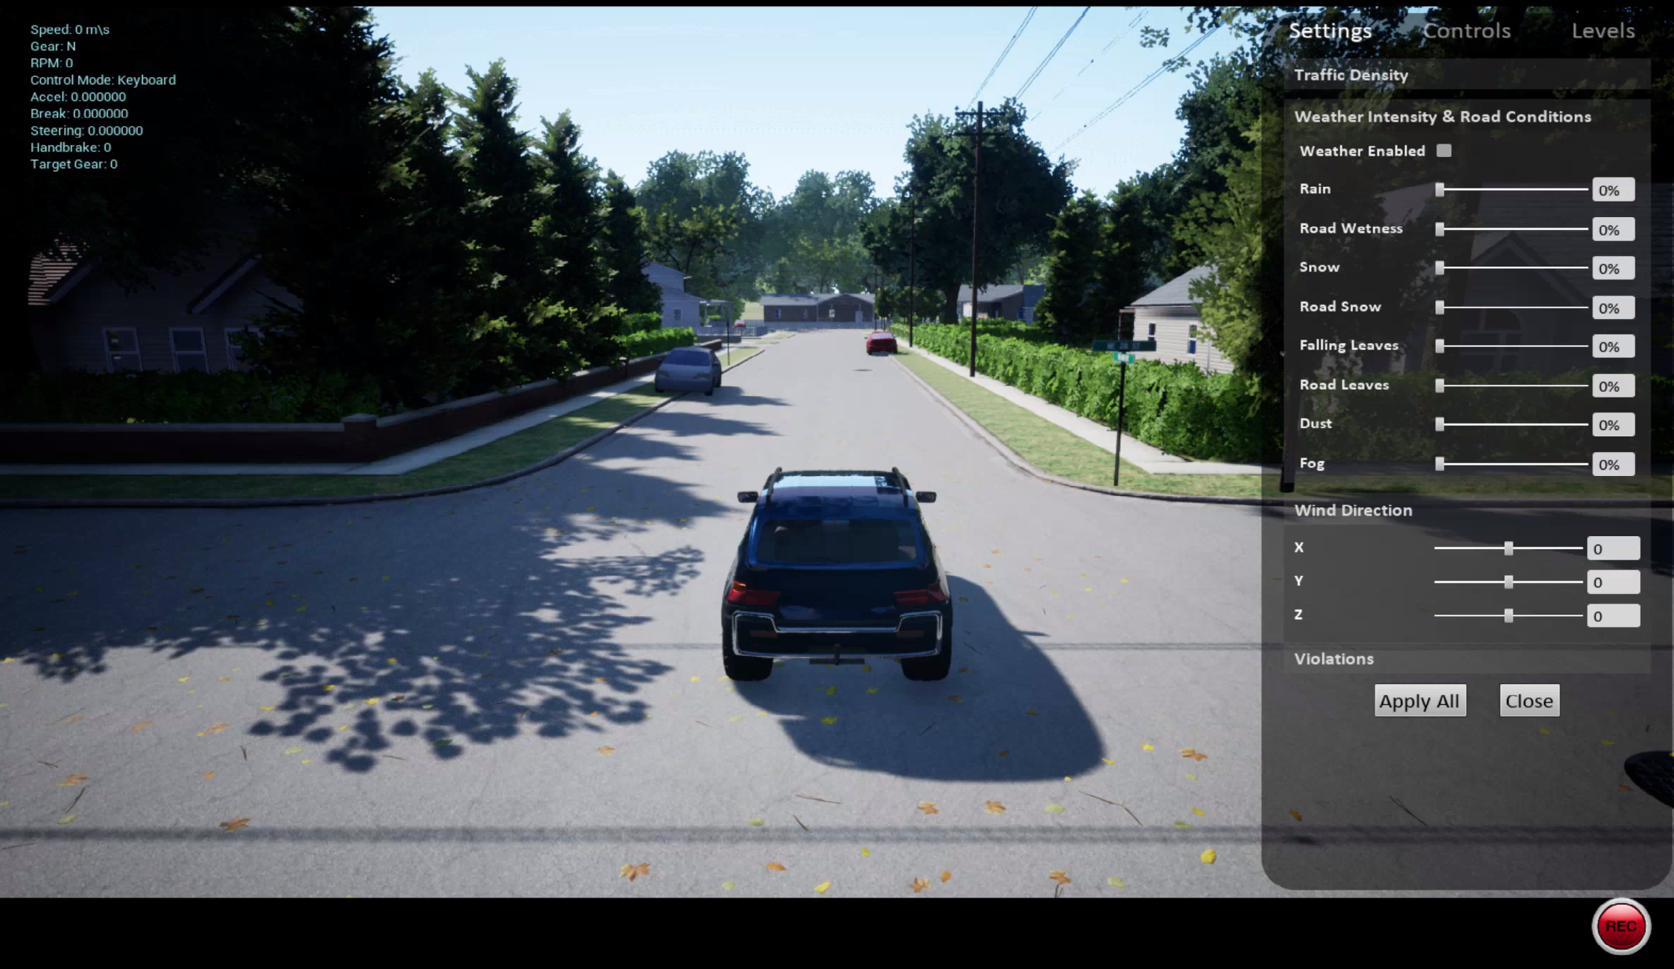
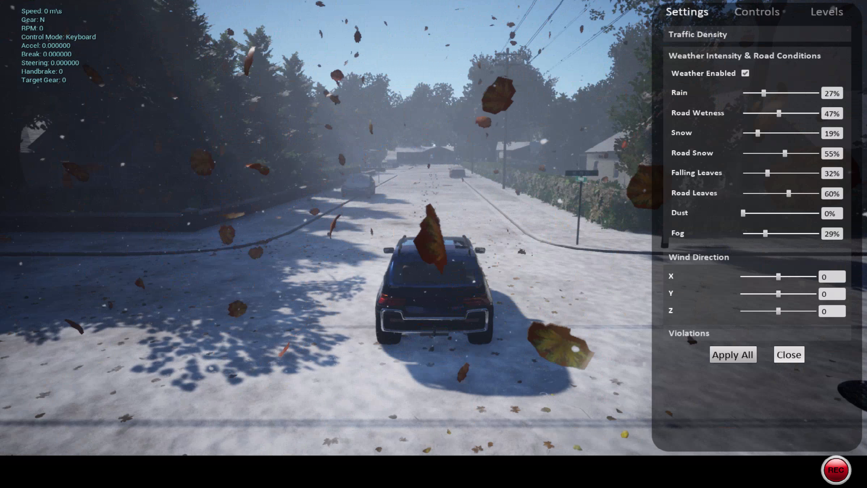
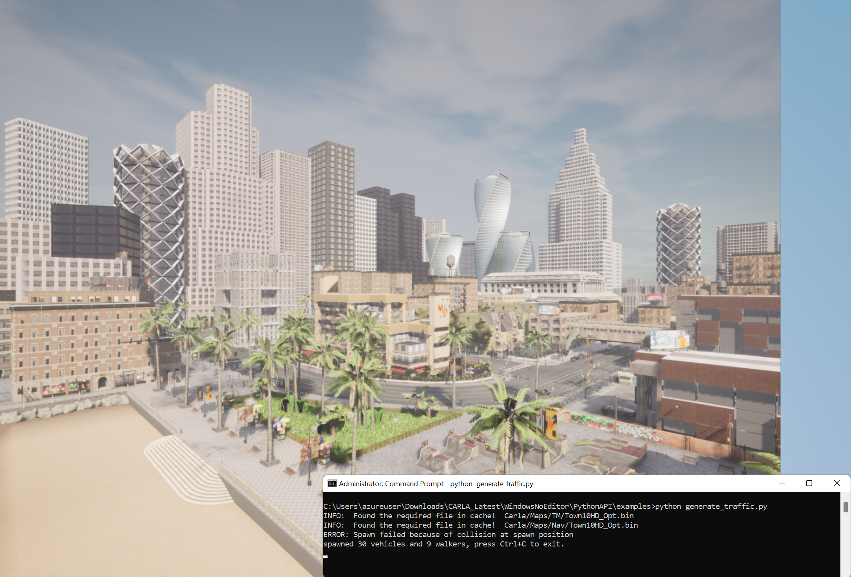
Eclipse Software Defined Vehicle Projects
In-Vehicle Application
Deploy it to a vehicle model
Kuksa
Velocitas
Chariott
In-Vehicle Application
a game
a Virtual to Physical App
… to test and build the next gen Software Defined Vehicle Applications …
… and use the simulated data and images or API to…
Simulate Vehicle Data…
…in multiple weather conditions…
… in multiple vehicle and pedestrians' scenarios…

